Slide 1

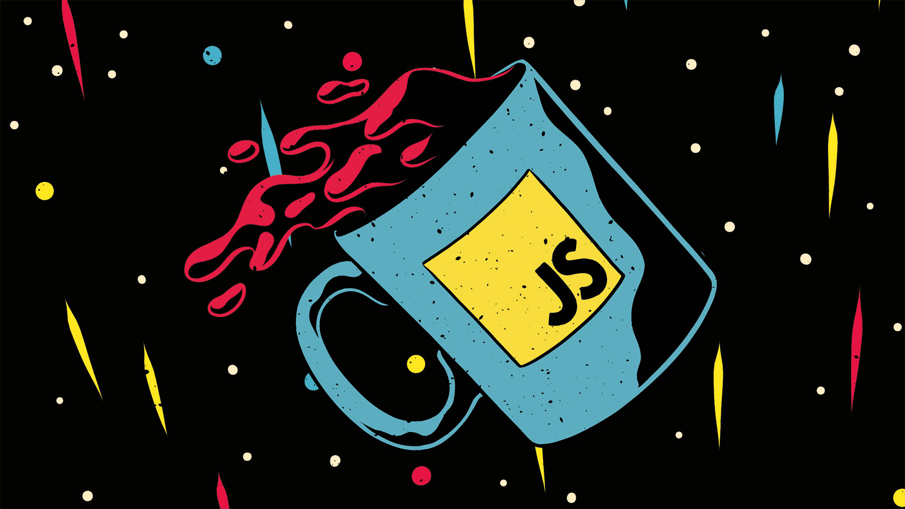
Introduction to JavaScript

Slide 2
Topics
What is JavaScript?
What's Java?
What can you do with it?
Where does Javascript code run?
JavaScript Vs ECMAScript?
What is JavaScript and Java?
*

Slide 3
What is JavaScript?
Created by Netscape
  Originally called Mocha, LiveWire then LiveScript
A client-side scripting language
  Client-side refers to the fact that it is executed in the client (software) that the viewer is using. In the case of JavaScript, the client is the browser.
  A server-side language is one that runs on the Web server. Examples: PHP, Python
Interpreted on-the-fly by the client
  Each line is processed as it loads in the browser
*

Slide 4
Why JavaScript?
It’s easier to learn than most programming languages
It allows you to make interactive Web pages
It can be fun!
*

Slide 5

What can you do with JavaScript?
  Facebook and
  Google
*

Slide 6
JavaScript Today
Web / Mobile Apps
Real-time
Networking Apps
Command-line Tools
Games
*

Slide 7
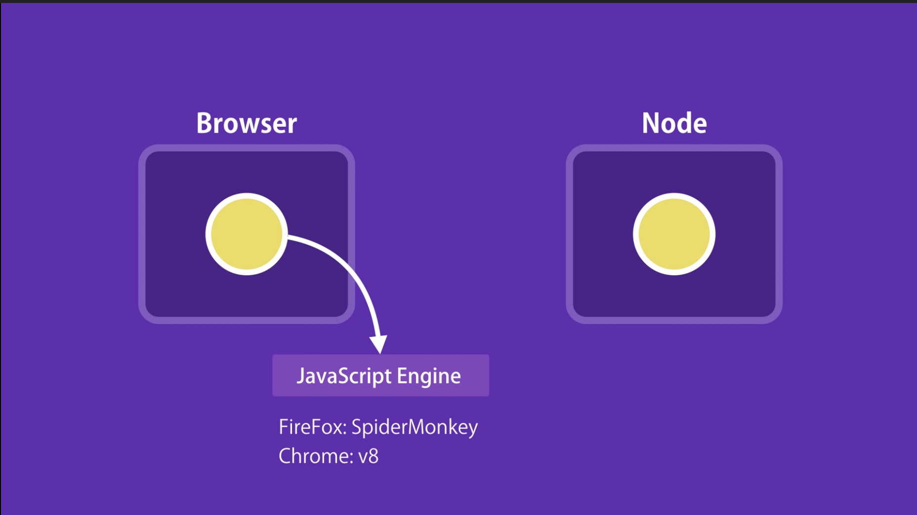
Where does Javascript code run?
*

Slide 8
JavaScript is not Java
Completely different types of languages that just happen to be similarly named
  JavaScript - programs are interpreted in the browser
  Java - programs are compiled and can be run as stand alone applications
*

Slide 9

*

Slide 10
Thanks for your attentions!
for any question
geme.t07@gmail.com
*

